Slide 1
Internet of Things

Slide 2
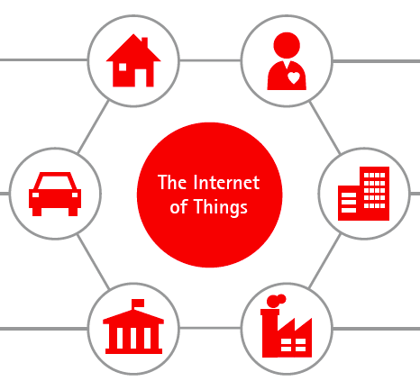
What is Internet of Things ?
The Internet of Things (IoT) is the network of physical objects—devices, vehicles, buildings and other items embedded with electronics, software, sensors, and network connectivity—that enables these objects to collect and exchange data.
Connected Home
Connected Health
Connected Car
Connected City
Connected Government
Connected Enterprise

Slide 3
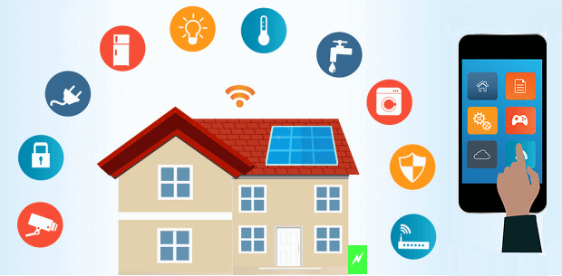
IoT Connected Home

Slide 4
What is Connected Home (Smart Home)
A "Connected Home" is one where multiple "smart" devices are integrated together creating an environment that can be automated and easily controlled. Smart devices are typically controllable by an app. Common devices in a "Connected Home" include:
Smart thermostats (Nest, Hive, Honeywell)
Smart speakers (Sonos)
Smart lights (Lutron, Hue, LIFX),
Smart cameras (Nestcam, IP cameras)
As well as sensors, locks, shades, garage doors, etc.

Slide 5
Advantages of Smart Homes
Control at Your Fingertips
Basically any appliance in the home can be controlled using an app on the phone
For example: Preheated home before you reach home from work
Safety
Avert accidental house fires
Security Systems to monitor the house surroundings
Accessibility
Voice-command systems can do things like control lights, lock doors, operate a telephone or use a computer.
Time
We can save lot of time by programming different appliances.
Energy Efficiency
Lights can be shut off automatically when no one is in a room,
Thermostat can be set to let the indoor temperature drop during the day before returning it to a more comfortable level just before residents arrive in the evening.

